Slide 1
Use HAPI for Easy Data Access
Jon Vandegriff, JHU / APL

Slide 2
Data
Servers
Access
Method
CDAWeb
HAPI
Custom
SSCWeb
HAPI
HAPI offers a single way to obtain data
from many repositories
Custom
INTER-MAGNET
HAPI
Custom
HAPI standardizes key data access pain points:
VirES / SWARM
HAPI
Same way to request the data.
Same arrangement (data structures) of returned data.
Custom

Slide 3
Python code to get data is short
# example showing how to get OMNIWeb data
from hapiclient import hapi
server = 'https://cdaweb.gsfc.nasa.gov/hapi'
dataset = 'OMNI2_H0_MRG1HR'
start = '2021-10-25T00:00:00Z'
stop = '2021-12-01T00:00:00Z'
# parameters is a comma-separated list
parameters = 'DST1800,Proton_QI1800'
# Configuration options for the hapi function.
opts = {'logging': True, 'usecache': True, 'cachedir': './hapicache' }
# Get parameter data
data, meta = hapi(server, dataset, parameters, start, stop, **opts)

Slide 4
Python code to get different data is nearly the same
# example showing how to get OMNIWeb data
from hapiclient import hapi
server = 'https://cdaweb.gsfc.nasa.gov/hapi'
dataset = 'OMNI2_H0_MRG1HR'
start = '2021-10-25T00:00:00Z'
stop = '2021-12-01T00:00:00Z'
# parameters is a comma-separated list
parameters = 'DST1800,Proton_QI1800'
# Configuration options for the hapi function.
opts = {'logging': True, 'usecache': True, 'cachedir': './hapicache' }
# Get parameter data
data, meta = hapi(server, dataset, parameters, start, stop, **opts)

Slide 5
Python code to get different data is nearly the same
# example showing how to get OMNIWeb data
from hapiclient import hapi
server = 'https://cdaweb.gsfc.nasa.gov/hapi'
dataset = 'RBSP-A_DENSITY_EMFISIS-L4'
start = '2021-10-25T00:00:00Z'
stop = '2021-12-01T00:00:00Z'
# parameters is a comma-separated list
parameters = 'density'
# Configuration options for the hapi function.
opts = {'logging': True, 'usecache': True, 'cachedir': './hapicache' }
# Get parameter data
data, meta = hapi(server, dataset, parameters, start, stop, **opts)

Slide 6
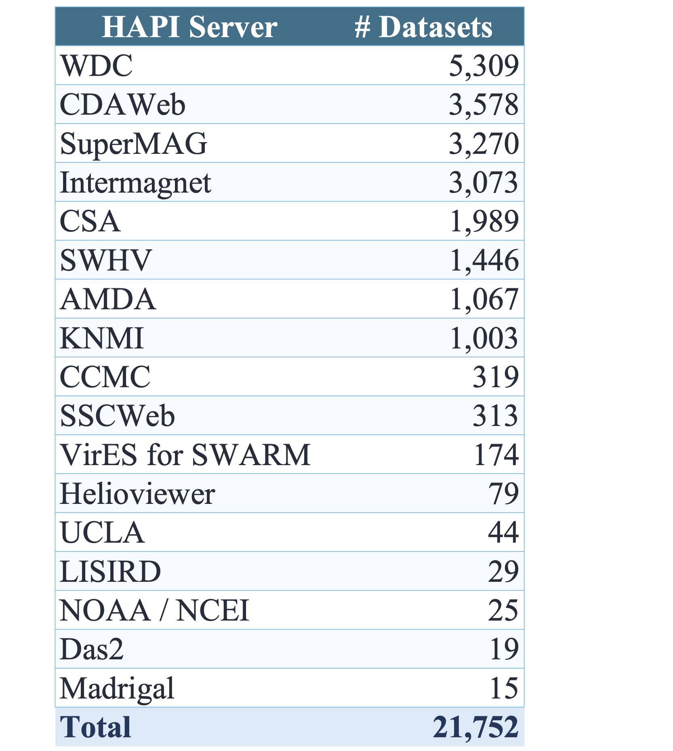
Many Datasets Now Available!

Slide 7

Try out HAPI using the HAPI Data Explorer
http://hapi-server.org/servers
Data request for EMFISIS
Steps to take:
For “HAPI servers” : select CDAWeb
For “Datasets”: select RBSP-A_DENSITY_EMFISIS-L4
For “Parameters”: select “electron density”
For the time range: the defaults are ok
For output: select Data
For format: select CSV
(can also select Image, or Script)
https://cdaweb.gsfc.nasa.gov/hapi/data?id=RBSP-A_DENSITY_EMFISIS-L4&parameters=density&time.min=2012-09-15T00:00:03Z&time.max=2012-09-17T00:00:03.000Z

Slide 8
Visit the tables!
More about HAPI data that is available.
HAPI tutorials in HelioCloud
Help with specific questions!

